Slide 1
Assignment
Akanksha Sharma

Slide 2

Scenario 1 Which customers should Bank X provide their service to and why?

Slide 3
Scenario 1
Criteria: Based on the below variables I have selected the top 5 suppliers Bank X should provide their service.
1.Contract End Date : This is the end date that performance of the contract is expected to be completed. I have selected the date should be greater than the 2021-07-30, so that bank X will offer at least one month of service to the suppliers. This value can be changed according to the Bank X requirement.
2. Amendment Start Date: This is the date the Amendment took effect. This variable is taken into account to make sure that the contract if the contract is ended as per the end date or some changes has been made.
3. Exempt: Contract notices with a value at or above $80,000. I have considered the tenders which are at or above $80,000 because as this exemption cost is high, suppliers may come to the bank for finance purpose.
I have choosen the suppliers as a Bank X Customers because government agencies has already given the contract to them and suppliers will seek the direct help from the Bank.
Notes:
For this task my objective is Firstly, to categorize histopathological colon cancer cells as cancerous cells or not (‘isCancerous’). Secondly, to classify them according to ‘cellType’, such as fibroblast, inflammatory, epithelial or others to successfully classify histological colon cancer cells

Slide 4
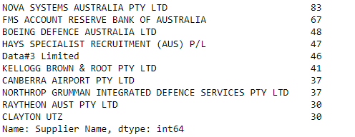
Approach: In order to get the list of the customers a bank X should consider , I have taken those selections factors in mind and filtered out the data as per the conditions. I have only targeted the top 5 values for this assignment purpose by taking out the count of each suppliers. This indicates that the most appeared suppliers are most likely to get the contracts from the government agencies. Top 5 Suppliers:
Scenario 1: List of top 5 Suppliers
Notes:
Solution to our problem,
In Baseline model RELU activation function is used in the input layers in order to avoid negative values.SOFTMAX activation function is used in the output layer to get the probabilities for the target classes where probabilities add up to 1. Adam Optimizer with default learning rate is used because it combines the best properties of AdaGrad and RMSProp.Binary Cross Entropy and Sparse Categorical Cross Entropy Loss functions were used for Binary and multi class classification respectively Zero Padding is used in each conv2D layer to retrieve the same dimension of feature map without information loss. Total trainable parameters in our model are 287,042.

Slide 5
Scenario 2 To meet with agency/supplier representatives regularly, where should Bank X set up their office(s) to serve them better?

Slide 6
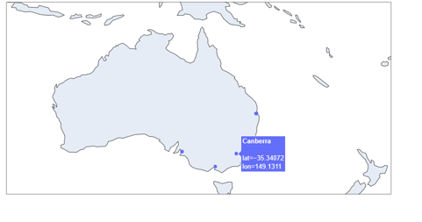
Bank X should select the locations at the suppliers postcode. It is going to be easy for the Bank X to meet the suppliers representatives on regular basis. List of Bank X office setup locations based on the suppliers office postcode: 1. Brisbane 2. Toowong 3. Indooroopilly 4. Sydney 5. North Sydney 6. Canberra 7. Hawthorn East 8. Mile End South
Scenario 2 a: The choices of locations
Notes:
Solution to our problem,
In Baseline model RELU activation function is used in the input layers in order to avoid negative values.SOFTMAX activation function is used in the output layer to get the probabilities for the target classes where probabilities add up to 1. Adam Optimizer with default learning rate is used because it combines the best properties of AdaGrad and RMSProp.Binary Cross Entropy and Sparse Categorical Cross Entropy Loss functions were used for Binary and multi class classification respectively Zero Padding is used in each conv2D layer to retrieve the same dimension of feature map without information loss. Total trainable parameters in our model are 287,042.

Slide 7
As the rent in capital cities is generally high, I had to reconsider for the alternate locations to setup an office for bank X. Based on the nearest suburb to the CBD or Capital area, Bank can setup their offices. To carry out this requirement, I have merged another Australian postcode longitude and latitude dataset. I have calculated the distances from the selected suppliers to the nearest location.
Scenario 2 b: The alternative locations
Notes:
Solution to our problem,
In Baseline model RELU activation function is used in the input layers in order to avoid negative values.SOFTMAX activation function is used in the output layer to get the probabilities for the target classes where probabilities add up to 1. Adam Optimizer with default learning rate is used because it combines the best properties of AdaGrad and RMSProp.Binary Cross Entropy and Sparse Categorical Cross Entropy Loss functions were used for Binary and multi class classification respectively Zero Padding is used in each conv2D layer to retrieve the same dimension of feature map without information loss. Total trainable parameters in our model are 287,042.

Slide 8
Scenario 3 Machine learning Use Case

Slide 9
Problem Statement: Predicting the probable cost of a tender. Proposed Solution: With the given data, we can propose the price of a future tender based on the past tender rates for the agencies. For this we use the variables like agency name, tender age, tender confidential type, procurement method, UNPSC Title, Consultancy flag, supplier country code as my independent features and value of the tender as my target variable. ML Algorithm: I have chosen the Baseline model as Linear regression. Pros/Cons: Pros: This gives us an idea what would be the cost of new contract/tender. Cons: Data Cleaning is to be done and external factors are not considered.
Scenario 3: Machine Learning Use Case
Notes:
Solution to our problem,
In Baseline model RELU activation function is used in the input layers in order to avoid negative values.SOFTMAX activation function is used in the output layer to get the probabilities for the target classes where probabilities add up to 1. Adam Optimizer with default learning rate is used because it combines the best properties of AdaGrad and RMSProp.Binary Cross Entropy and Sparse Categorical Cross Entropy Loss functions were used for Binary and multi class classification respectively Zero Padding is used in each conv2D layer to retrieve the same dimension of feature map without information loss. Total trainable parameters in our model are 287,042.

Slide 10
Thanks!

